Slide 1
Constraint Satisfaction Problems
Dr. Daisy Tang

Slide 2
Standard Search Problems
Previous search problems:
Problems can be solved by searching in a space of states
state is a “black box” – any data structure that supports successor function, heuristic function, and goal test – problem-specific
Constraint satisfaction problem
states and goal test conform to a standard, structured and simple representation
general-purpose heuristic

Slide 3
Constraint Satisfaction Problems (CSP)
CSP is defined by 3 components (X, D, C):
state: a set of variables X, each X_{i} , with values from domain D_{i}
goal test: a set of constraints C, each C_{i} involves some subset of the variables and specifies the allowable combinations of values for that subset
Each constraint C_{i} consists of a pair <scope, rel>, where scope is a tuple of variables and rel is the relation, either represented explicitly or abstractly
X1 and X2 both have the domain {A, B}
Constraints:
<(X1, X2), [(A, B), (B, A)]>, or
<(X1, X2), X1 ≠ X2>

Slide 4
Solution
Each state in a CSP is defined by an assignment of values to some or all of the variables
An assignment that does not violate any constraints is called a consistent or legal assignment
A complete assignment is one in which every variable is assigned
A solution to a CSP is consistent and complete assignment
Allows useful general-purpose algorithms with more power than standard search algorithms

Slide 5
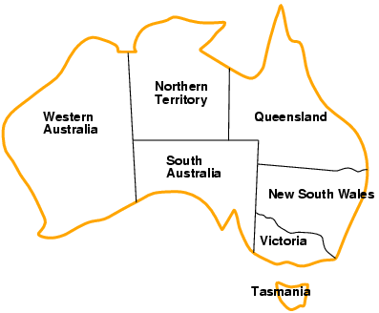
Example: Map Coloring
Variables: X = {WA, NT, Q, NSW, V, SA, T }
Domains: D_{i} = {red, green, blue}
Constraints: adjacent regions must have different colors
Solution?

Slide 6
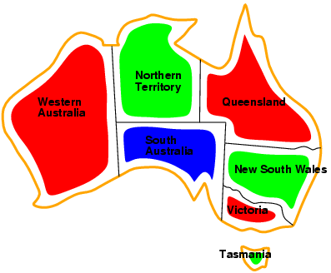
Solution: Complete and Consistent Assignment
Variables: X = {WA, NT, Q, NSW, V, SA, T }
Domains: D_{i} = {red, green, blue}
Constraints: adjacent regions must have different colors
Solution? {WA = red, NT = green, Q = red, NSW = green, V = red, SA = blue, T = red}.

Slide 7
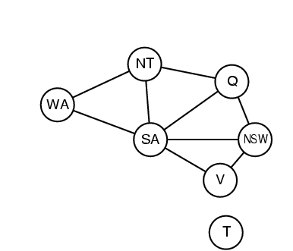
Constraint Graph
Constraint graph: nodes are variables, arcs are constraints
Binary CSP: each constraint relates two variables
CSP conforms to a standard pattern
a set of variables with assigned values
generic successor function and goal test
generic heuristics
reduce complexity

Slide 8
CSP as a Search Problem
Initial state:
{} – all variables are unassigned
Successor function:
a value is assigned to one of the unassigned variables with no conflict
Goal test:
a complete assignment
Path cost:
a constant cost for each step
Solution appears at depth n if there are n variables
Depth-first or local search methods work well

Slide 9
CSP Solvers Can be Faster
CSP solver can quickly eliminate large part of search space
If {SA = blue}
Then 3⁵ assignments can be reduced to 2⁵ assignments, a reduction of 87%
In a CSP, if a partial assignment is not a solution, we can immediately discard further refinements of it

Slide 10
Types of Variables
Discrete variables
finite domains:
n variables, domain size d → O (d ^{n}) complete assignments
e.g., Boolean CSPs, such as 3-SAT (NP-complete)
Worst case, can’t solve finite-domain CSPs in less than exponential time
infinite domains:
integers, strings, etc.
e.g., job scheduling, variables are start/end days for each job
need a constraint language, e.g., StartJob₁ + 5 ≤ StartJob₃
Continuous variables
e.g., start/end times for Hubble Space Telescope observations
linear constraints solvable in polynomial time by linear programming

Slide 11
Types of Constraints
Unary constraints involve a single variable,
e.g., SA ≠ green
Binary constraints involve pairs of variables,
e.g., SA ≠ WA
Higher-order constraints involve 3 or more variables
e.g., cryptarithmetic column constraints

Slide 12
Real-World CSPs
Assignment problems
e.g., who teaches what class
Timetabling problems
e.g., which class is offered when and where?
Transportation scheduling
Factory scheduling

Slide 13
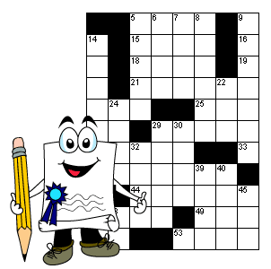
In-Class Exercise #6.1
Consider the problem of crossword puzzle: fitting words into a rectangular grid. Assume that a list of words is provided and that the task is to fill in the blank squares using any subset of the list. Formulate this problem precisely in two ways:
As a general search problem. Choose an appropriate search algorithm.
As a constraint satisfaction problem.
Word vs. letters

Slide 14
In-Class Exercise #6.2
Problem formulation as CSP:
Class scheduling: There is a fixed number of professors and classrooms, a list of classes to be offered, and a list of possible time slots for classes. Each professor has a set of classes that he or she can teach.

Slide 15
What Search Algorithm to Use?
Since we can formulate CSP problems as standard search problems, we can apply search algorithms from chapter 3 & 4
If breadth-first search were applied
branching factor? nd
tree size? nd * (n-1)d * … * d = n! * d^{n} leaves
complete assignments? d^{n}
A crucial property to all CSPs: commutativity
the order of application of any given set of actions has no effect on the outcome
Variable assignments are commutative, i.e., [ WA = red then NT = green ] same as [ NT = green then WA = red ]

Slide 16
Backtracking Search
Only need to consider assignments to a single variable at each node → b = d and there are d ^{n} leaves
Backtracking search is used for a depth-first search that chooses values for one variable at a time and backtracks when a variable has no legal values left to assign
Backtracking search is the basic uninformed algorithm for CSPs

Slide 17
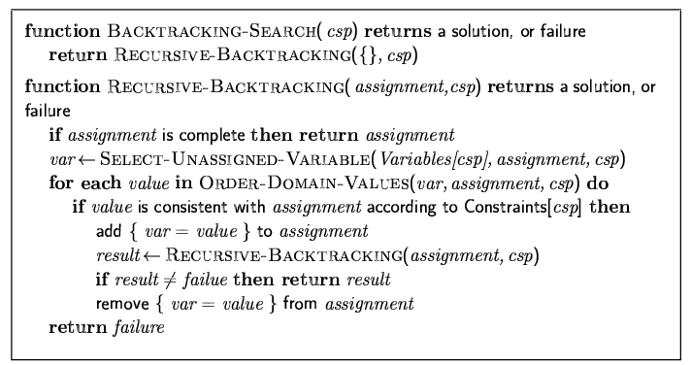
Backtracking Search Algorithm

Slide 18





Backtracking Example

Slide 19
Improving Backtracking Efficiency
We can solve CSPs efficiently without domain-specific knowledge, addressing the following questions:
in what order should variables be assigned, values be tried?
what are the implications of the current variable assignments for the other unassigned variables?
when a path fails, can the search avoid repeating this failure?

Slide 20

Variable and Value Ordering 1/3
Minimum remaining values (MRV)
choose the variable with the fewest “legal” values
also called most constrained variable or fail-first heuristic
does it help in choosing the first variable?

Slide 21

Variable and Value Ordering 2/3
Most constraining variable:
selecting the variable that has the largest number of constraints on other unassigned variables
also called degree heuristics
Tie-breaker among MRV

Slide 22
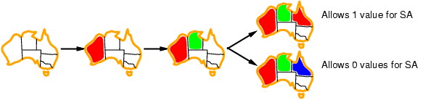
Variable and Value Ordering 3/3
Given a variable, choose the least constraining value:
the one that rules out the fewest values in the remaining variables
Combining these heuristics makes 1000 queens feasible

Slide 23
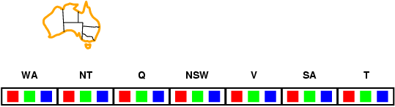
Propagating Information through Constraints
Forward checking:
Keep track of remaining legal values for unassigned variables
Terminate search when any variable has no legal values

Slide 24
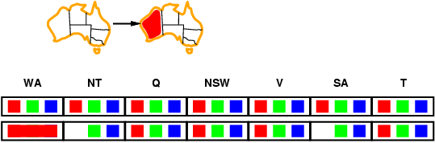
Propagating Information through Constraints
Forward checking:
Keep track of remaining legal values for unassigned variables
Terminate search when any variable has no legal values

Slide 25
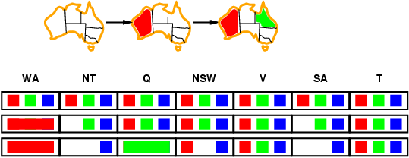
Propagating Information through Constraints
Forward checking:
Keep track of remaining legal values for unassigned variables
Terminate search when any variable has no legal values

Slide 26
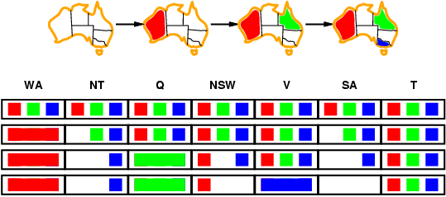
Propagating Information through Constraints
Forward checking:
Keep track of remaining legal values for unassigned variables
Terminate search when any variable has no legal values

Slide 27
Propagating Information through Constraints
Forward checking propagates information from assigned to unassigned variables, but doesn't provide early detection for all failures:
NT and SA cannot both be blue!
Constraint propagation repeatedly enforces constraints locally by propagating implications of a constraint of one variable onto other variables

Slide 28
Node Consistency
A single variable is node-consistent if all the values in the variable’s domain satisfy the variable’s unary constraints
For example, SA dislikes green
A network is node-consistent if every variable in the network is node-consistent

Slide 29
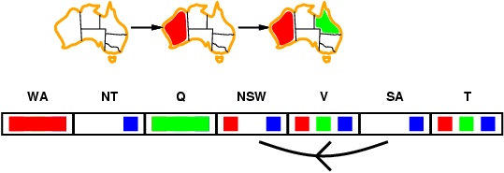
Arc Consistency
Simplest form of propagation makes each arc consistent
X →Y is consistent iff
for every value x of X there is some allowed y

Slide 30
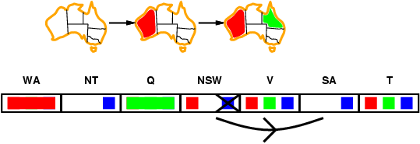
Arc Consistency
Simplest form of propagation makes each arc consistent
X →Y is consistent iff
for every value x of X there is some allowed y

Slide 31
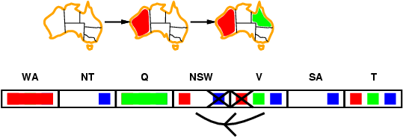
Arc Consistency
Simplest form of propagation makes each arc consistent
X →Y is consistent iff
for every value x of X there is some allowed y
If X loses a value, neighbors of X need to be rechecked

Slide 32
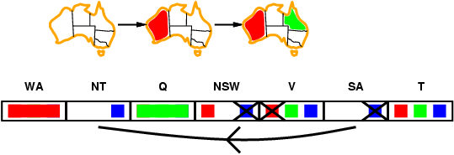
Arc Consistency
Simplest form of propagation makes each arc consistent
X →Y is consistent iff
for every value x of X there is some allowed y
If X loses a value, neighbors of X need to be rechecked
Arc consistency detects failure earlier than forward checking
Can be run as a preprocessor or after each assignment

Slide 33
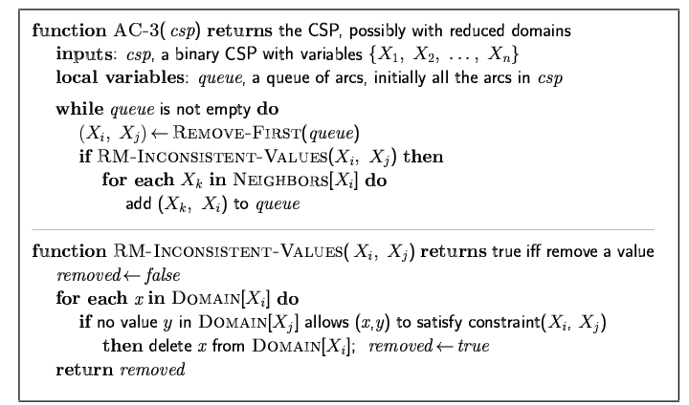
AC-3 Algorithm
Time complexity O (n ²d ³)

Slide 34
Example
Use the AC-3 algorithm to show that arc consistency is able to detect the inconsistency of the partial assignment {WA = red, V = blue} in the following map coloring problem.

Slide 35
One Possible Trace
One possible trace of the algorithm:
remove SA-WA, delete R from SA
remove SA-V, delete B from SA, leaving only G
remove NT-WA, delete R from NT
remove NT-SA, delete G from NT, leaving only B
remove NSW-SA, delete G from NSW
remove NSW-V, delete B from NSW, leaving only R
remove Q-NT, delete B from Q
remove Q-SA, delete G from Q
remove Q-NSW, delete R from Q, leaving no proper assignment for Q

Slide 36
In-Class Exercise #6.3
Use the AC-3 algorithm to show that arc consistency is able to detect the inconsistency of the partial assignment {WA = red, Q = blue} in the following map coloring problem.

Slide 37
Path Consistency
Consider map-coloring with only two colors
Every arc is consistent initially
Check the set {WA, SA} path consistenty with respect to NT
More generally, k-consistency
1-consistency = node consistency
2-consistency = arc consistency
3-consistency = path consistency

Slide 38
Local search for CSps

Slide 39
Local Search for CSPs
Hill-climbing, simulated annealing typically work with "complete" states, i.e., all variables assigned
To apply to CSPs:
allow states with unsatisfied constraints
operators reassign variable values
Variable selection: randomly select any conflicted variable
Value selection by min-conflicts heuristic:
choose value that violates the fewest constraints
i.e., hill-climb with h(n) = total number of violated constraints

Slide 40
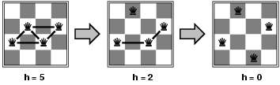
Example: 4-Queens
States: 4 queens in 4 columns (4⁴ = 256 states)
Actions: move queen in column
Goal test: no attacks
Evaluation: h(n) = number of attacks

Slide 41
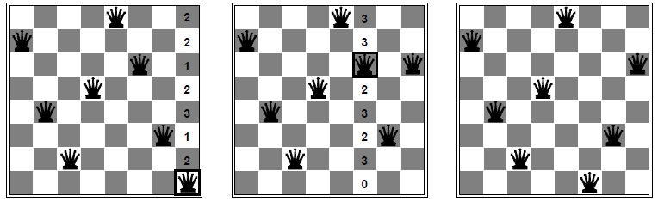
8-Queen Example
Min-conflicts is quite effective for many CSPs.
Given a random initial state, can solve n-queens in almost constant time for arbitrary n with high probability (e.g., n = 10,000,000)

Slide 42
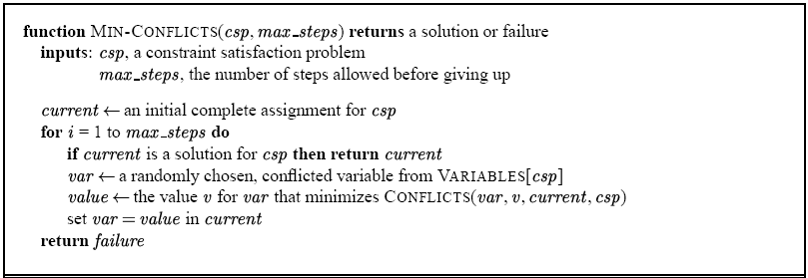
Min-Conflicts Algorithms for CSP

Slide 43
Summary
CSPs are a special kind of problem:
states defined by values of a fixed set of variables
goal test defined by constraints on variable values
Backtracking = depth-first search with one variable assigned per node
Variable ordering and value selection heuristics help significantly
Forward checking prevents assignments that guarantee later failure
Constraint propagation (e.g., arc consistency) does additional work to constrain values and detect inconsistencies
Iterative min-conflicts is usually effective in practice

